Slide 1
IEEE MCE | Virtual Events
David Stankiewicz: Event Producer MCE| Virtual Events Strategist
d.stankiewicz@ieee.org
Susan Root: Director MCE| Conference Business Services and Strategic Programs
s.root@ieee.org

Slide 2

Why virtual?
Engage audience & create community
Design personalized experiences & networking opportunities
Highlight compelling speakers & content
Generate excitement before an event
Extend the life of content after an event
Provide alternate participation options; (authors, governance meetings etc.)
Ensure authors are supported & enable publication for non-presented papers
Create promotional assets
Avoid event postponement or cancellation during emergencies

Slide 3




Virtual event formats
Virtual Conference
purely online event
options for participant networking
paper presentations
keynote speakers
live video and/or on-demand recordings
Webinar
technical presentation given by a thought leader
moderated chat & live Q&A with audience
delivered via Voice over PPT
Panel Discussion
livestreamed conversation
panel of 3-4 speakers
moderator
audience engagement via platform tools, social media and chat
Video Production
filmed, produced, and edited assets
showcase OU, conference, member benefits
highlight videos
sizzles
interviews
“Virtual events allow us to breakthrough the constraints of time and place to enrich and extend a live gathering,”
Marie Hunter, Senior Director, MCE

Slide 4
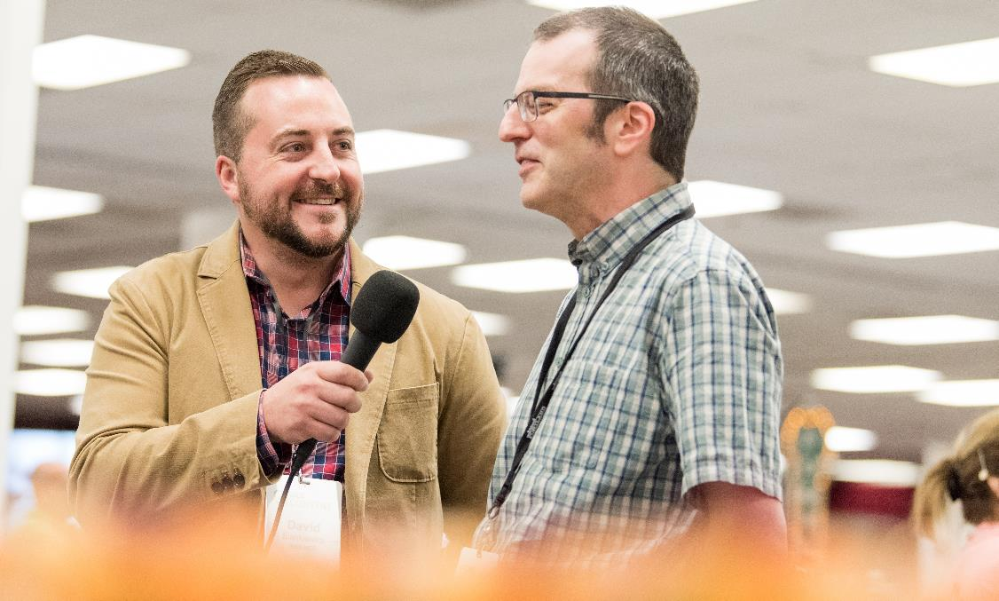
How we can help?
Expertise in:
Online, virtual, & digital event mediums
Multiple delivery methods
Event design, event moderation, and speaker management
Technical support and full, end-to-end event production
Nimbleness and flexibility to accommodate evolving needs
Developing a customized approach

Slide 5
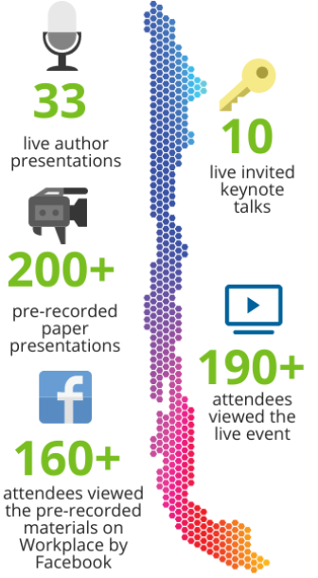
Case study – 2019 ChileCon
A cross-functional team from MGA, MCE, and IT helped quickly transform 2019 IEEE ChileCon into a virtual event.
The team helped the organizing committee to:
select the appropriate technologies,
provide authors with presentation options,
draft schedules and instructions,
communicate with attendees,
approve registrations,
produce virtual sessions, and
post materials to the various platforms.

Slide 6

Organizer feedback
The team transformed a seemingly insurmountable challenge into a “successful and professional” event.
Gastón Lefranc,
Co-Chair, 2019 ChileCon

Slide 7
Contact Us!
David Stankiewicz
Event Producer MCE | Virtual Events Strategist
d.stankiewicz@ieee.org
Susan Root
Director MCE| Conference Business Services and Strategic Programs
s.root@ieee.org

